Slide 2

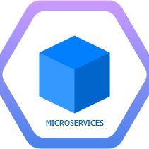
NAGP
Complex is Simple
New Technology Exploration Group
Introduction to Microservices and Containers

Slide 3

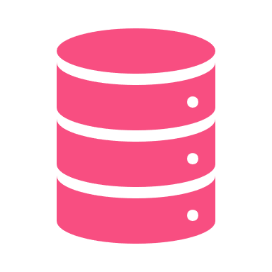

Workshop Agenda
Foundation
(This session)
Deep Dive
In Practice

Slide 4
Microservices Foundation - Agenda
Basics of Distributed applications
Journey to Microservices
Containers
Hands-on Docker

Slide 5
Basics of
Distributed Applications

Slide 6
Distributed Applications
Distributed applications (distributed apps) are applications or software that runs on multiple computers within a network at the same time and can be stored on servers or with cloud computing.
Microservices are one example of Distributed applications.

Slide 7
What we want to achieve with microservices?
Why a new architecture?
Microservices
Scalability
Development Efficiency
Fault tolerance
Localized Complexity

Slide 8
Scalability
What is scalability?
“Scalability is the property of a system to handle a growing amount of work by adding resources to the system.”
- Wikipedia
Notes:
Scalability is one of the main benefits of microservices along with 1. Increased dev. efficiency 2. Localized complexity 3. Better fault tolerance . But to start with we can start with just one main feature, scalability.

Slide 9



An Example: Applications and Deployments
How applications have evolved over time
You create an application
Your app will need resources to run on.
All good.

Slide 10

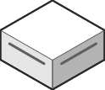

Applications and Deployments
How applications have evolved over time
What if the user’s system doesn’t have enough resources to run the app?
Server

Slide 11
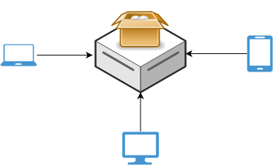
Applications and Deployments
How applications have evolved over time
We move applications to a server (Server-side applications)
How to handle increased load?

Slide 12
Scalability
How to handle increased load?
Horizontal Scaling (Increase system resources)
Benefits
Simple to implement
Drawbacks
No Elasticity
Costly
Inefficient utilization
There may be a limit on size of resources available

Slide 13
Scalability
How to handle increased load?
Vertical Scaling (Increase system instances)
Benefits
Elastic
Efficient utilization
Increase availability
Drawbacks
Complex than vertical scaling
State management not simple
Consistency management

Slide 14
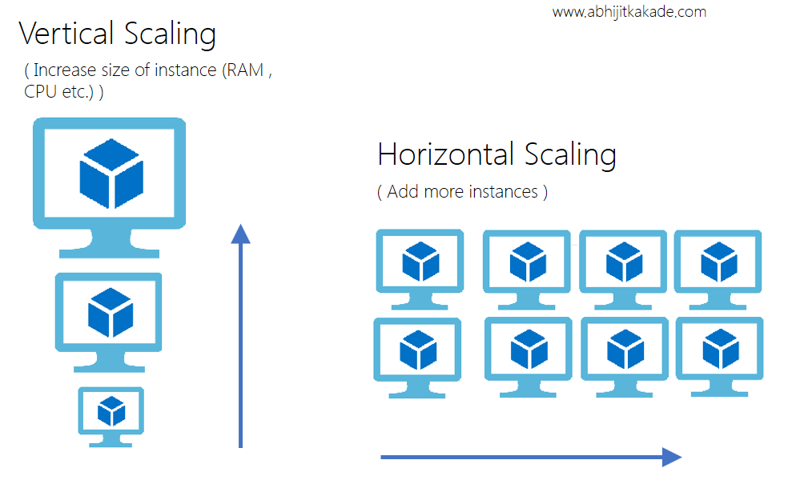
Horizonal vs Vertical Scaling

Slide 15
Stateful vs Stateless
A Stateful application saves data about each client session and uses that data the next time the client makes a request.
A Stateless app is an application program that does not save client data generated in one session for use in the next session with that client.

Slide 16
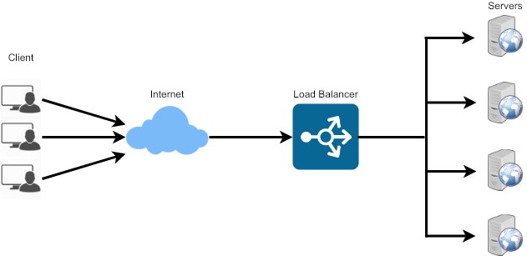
Load Balancing
How to distribute load between the distributed applications
Benefits of Load Balancers:-
Scalability
Availability

Slide 17
Load Balancing Techniques
How to distribute load between the distributed applications
Round Robin
Least Connection Method
Least Response Time Method
Least Bandwidth Method
Hashing Methods
Custom Load Method

Slide 18

State Management in action
Stateful vs Stateless APIs
Session
Session
User A LoggedIn=True
Load Balancer
Update
LoggedIn=True
Open Homepage

Slide 19
Advantages of Stateless APIs
Statelessness helps in scaling the APIs to millions of concurrent users by deploying it to multiple servers. Any server can handle any request because there is no session related dependency.
Being stateless makes REST APIs less complex – by removing all server-side state synchronization logic.
A stateless API is also easy to cache as well. A specific software can decide whether or not to cache the result of an HTTP request just by looking at that one request. There’s no nagging uncertainty that state from a previous request might affect the cacheability of this one. It improves the performance of applications.
The server never loses track of “where” each client is in the application because the client sends all necessary information with each request.

Slide 20
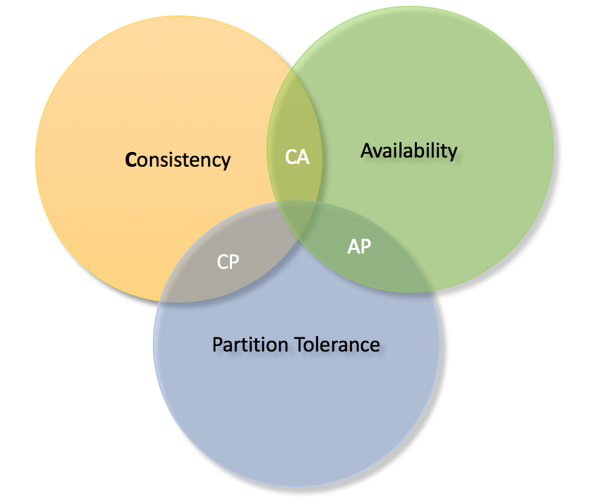
CAP Theorem
Consistency/Availability/Partition Tolerance
A system can have only 2 of the following:-
Consistency (C ): All nodes see the same data at the same time. What you write you get to read.
Availability (A): A guarantee that every request receives a response about whether it was successful or failed. Whether you want to read or write you will get some response back.
Partition tolerance (P): The system continues to operate despite arbitrary message loss or failure of part of the system. Irrespective of communication cut down among the nodes, system still works.

Slide 21
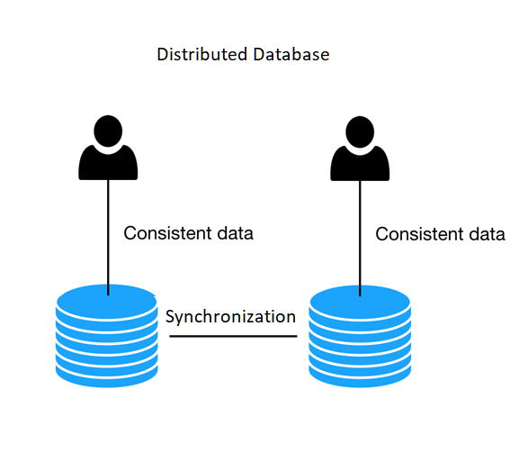
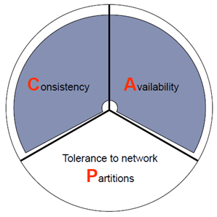
Example of a distributed database
Consistent and Available

Slide 22
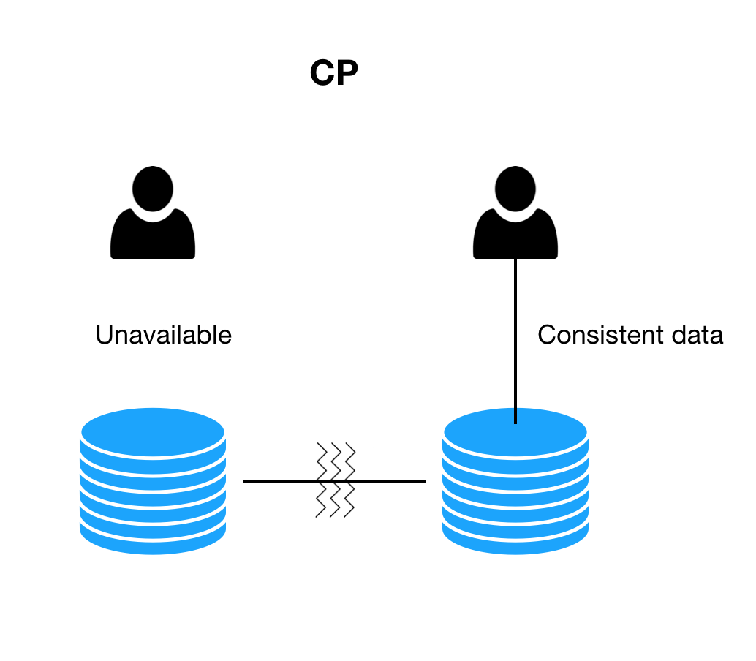
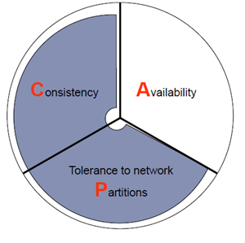
Consistent and Partition tolerant

Slide 23
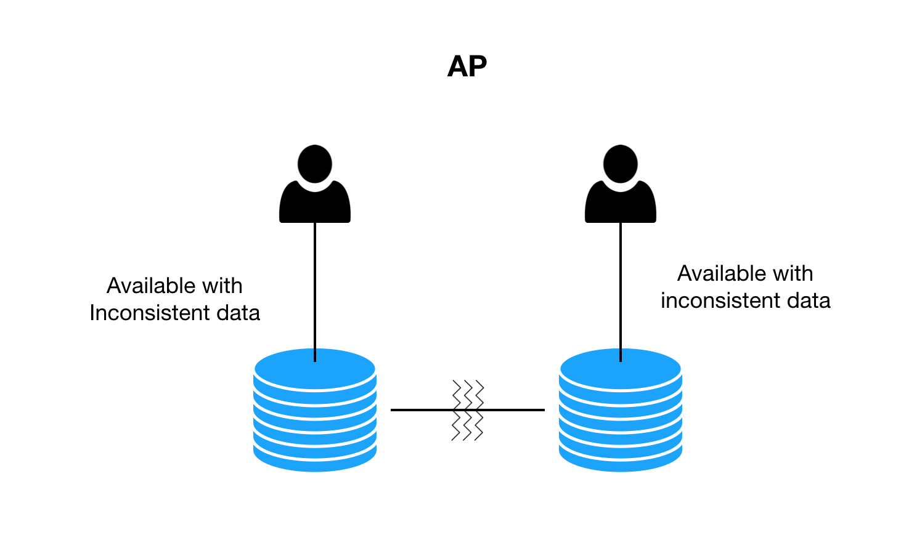
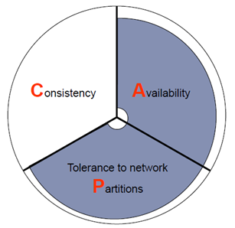
Available and Partition Tolerant

Slide 24

Journey From Monolithic to SOA To Microservices

Slide 25
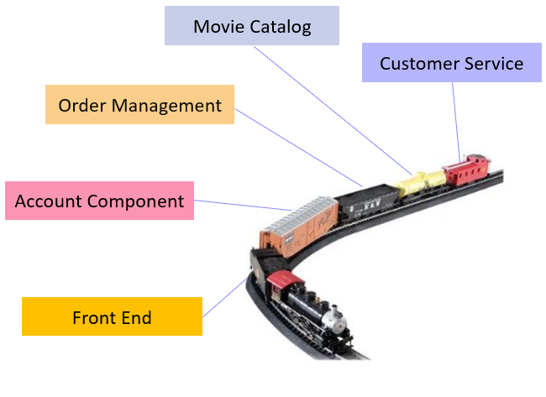
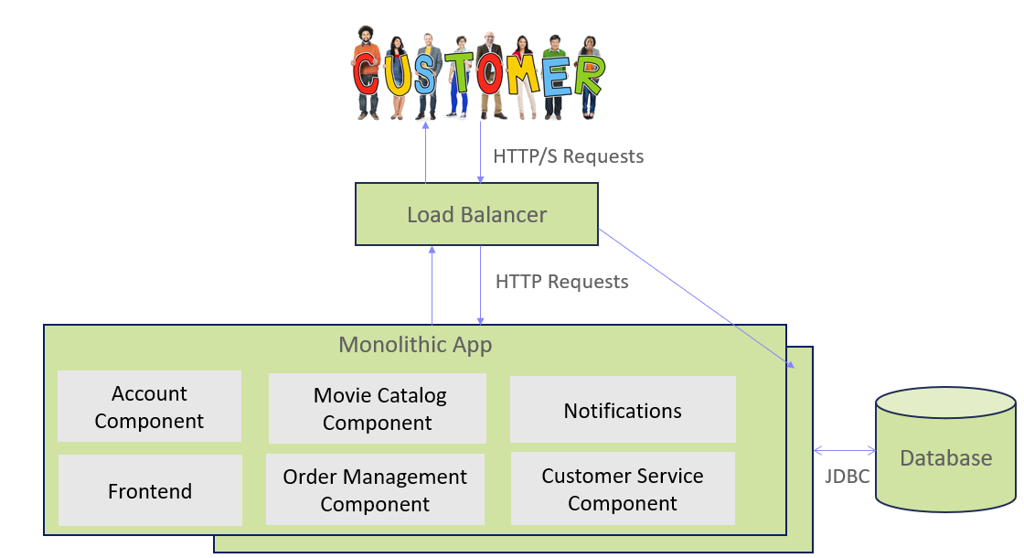
Monolithic Architecture
Single code base with multiple modules
Packaged and deployed as single module
Single Database
Can be called Multi-tier architecture
Best suited for small teams

Slide 26
Pros and Cons of Monolithic
PROS
Simple to develop
Simple to deploy
Simple to manage
Simple to test
Better performance
Fewer cross cutting concerns
Easy to scale horizontally
CONS
Less reliability
Single point of failure
Language/ Framework lock
Tight coupling between components
Deployment as a single unit
Development slows down
Resources are not optimized

Slide 27
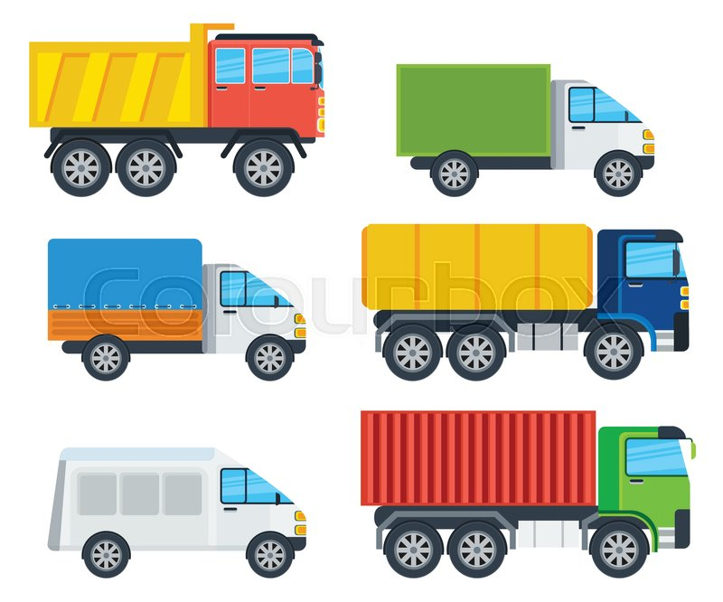
Service Oriented Architecture (SOA)
Customer Service
Entire application is broken down into multiple services/ features
Each service has a particular task
Loose coupling
Has two main roles: a service provider and a service consumer
Stateless Services
Services are built, consumed, and described using standards such as WSDL and SOAP
Can have multiple databases or single database for different services
Order Management
Account Component
Front End
Movie Catalog

Slide 28
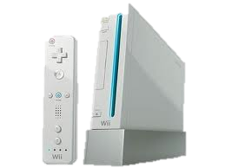
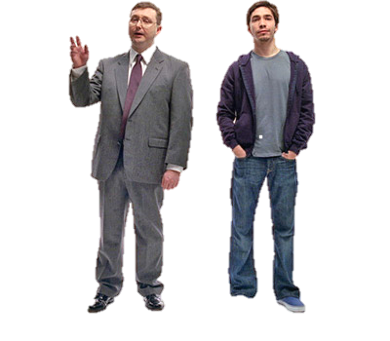

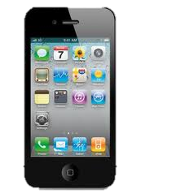
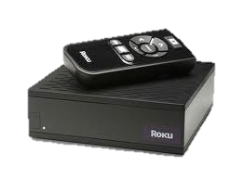
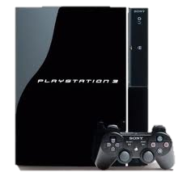

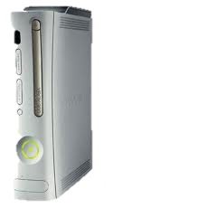
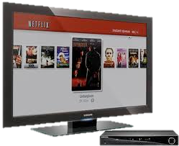
SOA Architecture
HTTP/S Requests
Load Balancer
Enterprise Service Bus
Frontend
Account Component
Movie Catalog
Component
Order Management
Component/billing
Customer Service
Component
Notifications
Database

Slide 29
Pros and Cons of SOA
PROS
Heterogenous Interoperability
Reusability of services
Better maintainability
Parallel Development
More Reliability
CONS
Extra overload
Complex management
High Investment cost
Deployment of entire service
Business Logic in ESB

Slide 30
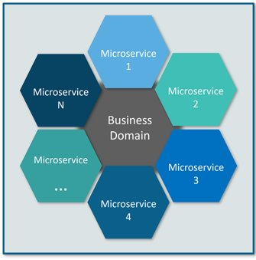
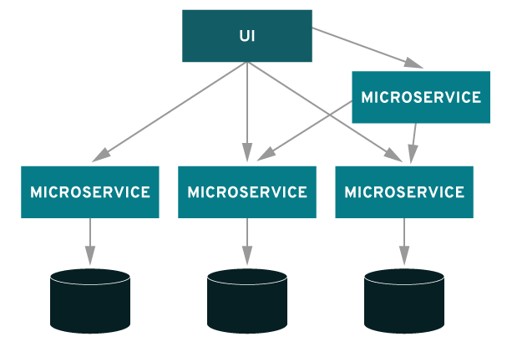
What are microservices?
Microservices Architecture is an architectural style that structures an application as a collection of small autonomous services, modelled around a business domain.
In this architecture, each service is self-contained and implements a single business capability.

Slide 31
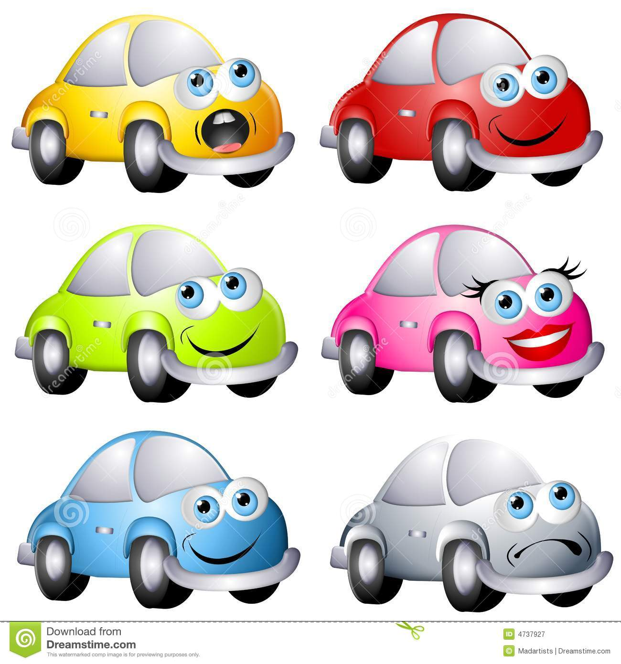
Characteristics
Payment Management
Customer Service
Small and focused
Language neutral
Bounded context
Loosely coupled
Independently deployable
Multiple code base
Highly maintainable and testable
Order Management
Front End
Account Component
Movie Data
Similar Movies
Recommendations

Slide 32
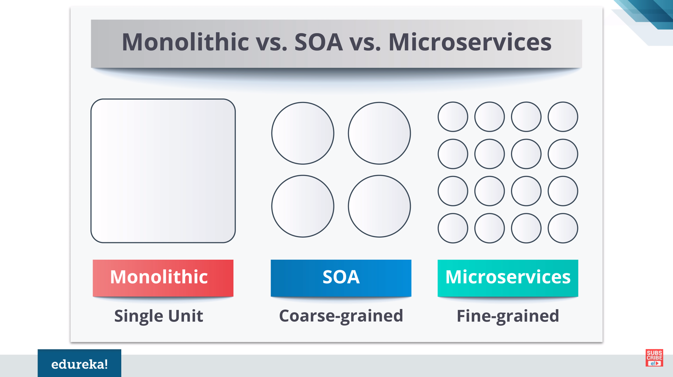
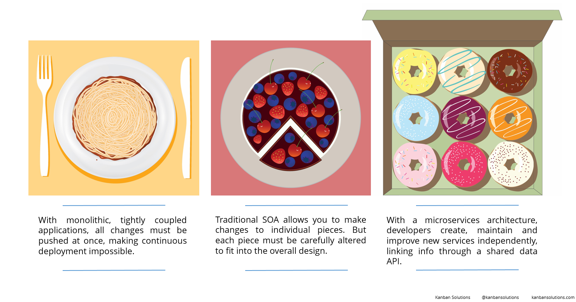
Monolithic vs SOA vs Microservices

Slide 33
Basics of Microservices

Slide 34
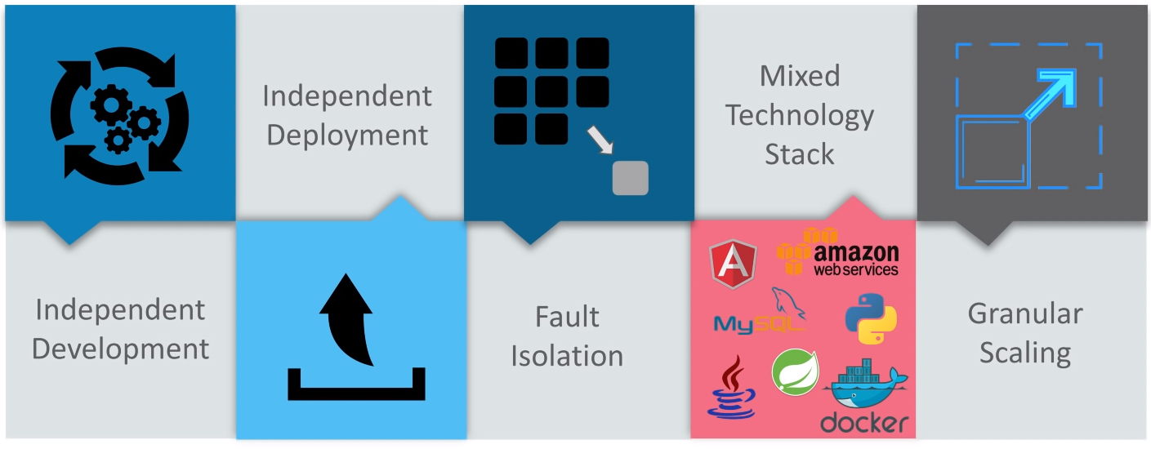
Why microservices is a right choice?

Slide 35

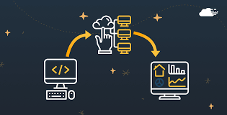
How "Not" to identify microservices
01
A microservice should have “x” lines of code
02
Turn each function into a microservice

Slide 36
Characteristics of a good microservice design
has a minimal amount of database tables
is thoughtfully stateful or stateless
A well-designed service…
doesn’t share database tables with another service
has its data availability needs accounted for
is a single source of truth

Slide 37
When to Choose Microservices?
MSA
Fast preferred over elegance
Functional isolation and simple integration preferred over module cohesiveness
Frequent change in application’s functionality & usage for agility
Functionality is easily separated into simple, isolatable components

Slide 38
When not to use microservice architecture?
If complexity isn't your problem, microservices aren't the solution.
Living with a Legacy
Lean and Tight: Some applications by their nature require tight integration between individual components and services
Too Small to Break Down

Slide 39
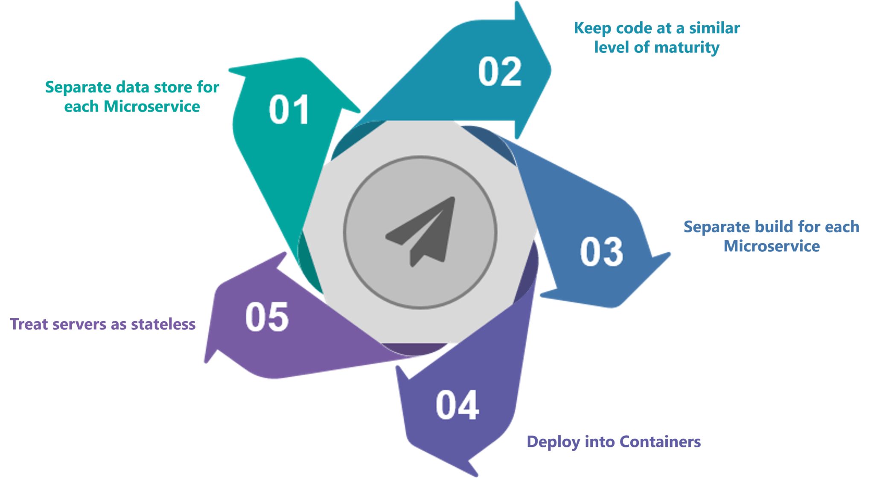
Microservices Best Practices

Slide 40
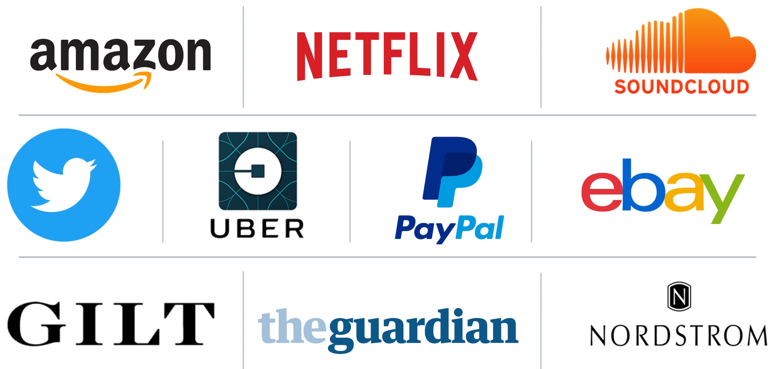
Who all are using Microservices?

Slide 41
Deployment Patterns for Microservices

Slide 42
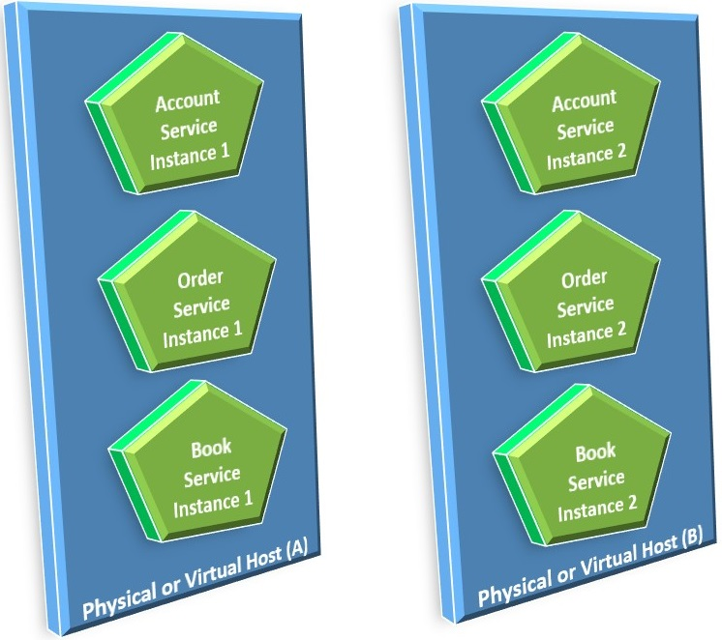
Multiple Service Instances per Host Pattern
Overview:
Provision one or more physical or virtual hosts and run multiple service instances on each one
Each instance of the service runs on a different well-known port on one host
Benefits:
Efficient resource utilization.
Deploying a service instance is relatively fast.
Drawbacks:
You get little to no isolation between various service instances
Poor visibility on how the services are behaving like memory and CPU utilization
Difficult to constrain the resources a particular service can use
Risk of dependency version conflicts
Poor encapsulation of implementation technology. One person needs to have detailed knowledge of the technology stack and mechanism used by each service

Slide 43
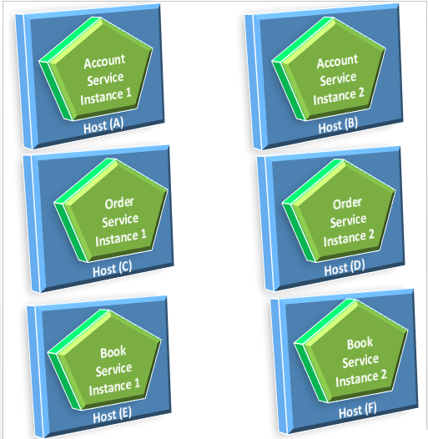
Single Service Instances per Host Pattern
Overview:
Deploy each single service instance on its own host
A host can be a physical machine, a virtual machine, or a container
Benefits:
Services instances are isolated from one another
There is no possibility of conflicting resource requirements or dependency versions
A service instance can only consume at most the resources of a single host
Its straightforward to monitor, manage, and redeploy each service instance
Drawbacks:
Potentially less efficient resource utilization

Slide 44
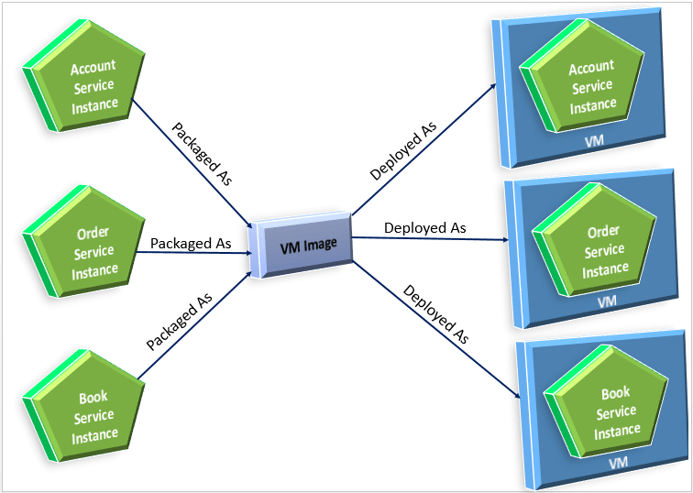
Single Service Instances per VM Pattern
Overview:
Package each service as a virtual machine image
Deploy each instance as a virtual machine instance
Benefits:
The VM encapsulates the details of the technology used to build the service.
Each service instance is isolated
you can leverage cloud infrastructure for auto-scaling and load balancing
A VM imposes limits on the CPU and memory consumed by a service instance
Drawbacks:
Less efficient resource utilization
Building a VM image is slow and time-consuming
Overhead of handling the building and managing the VMs
In some cases, it will take some time for the virtual machines to boot up

Slide 45
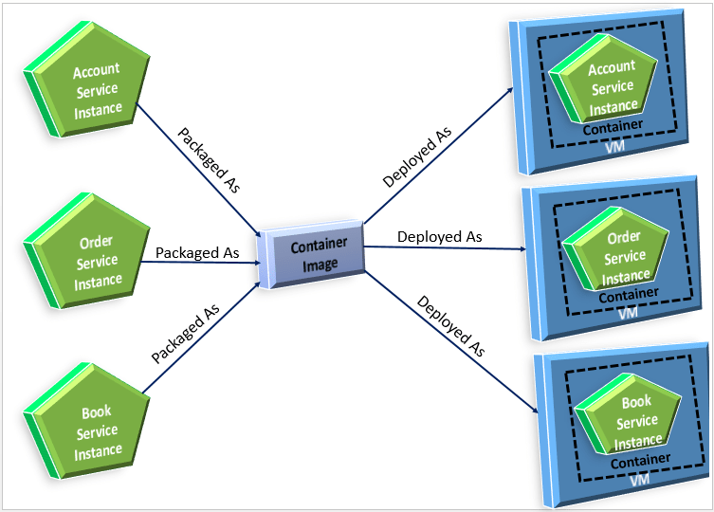
Single Service Instances per Container Pattern
Overview:
Each service is packaged as a container image
Each service instance is deployed as running container
Benefits:
Greater isolation as each container is highly isolated from each other at OS level
Greater manageability with containers
Container encapsulates the implementation technology
As containers are lightweight, they have s efficient resource utilization
Fast deployments
Drawbacks:
The infrastructure for deploying containers is not as rich as the infrastructure for deploying virtual machines.

Slide 46

Serverless Deployment Pattern
Overview:
The serverless deployment hides the underlying infrastructure, takes your service’s code and runs it.
Package the code (e.g. as a ZIP file), upload it to the deployment infrastructure and describe the desired performance characteristics.
Various public cloud providers are offering this service
Benefits:
Focus is on the code and application and not the underlying infrastructure
No worries about scaling as it will automatically scale in case of load
Pay for what is being used and not for the resources provisioned
Drawbacks:
Many constraints and limitations like limited languages support, suits better only for stateless services
Can only respond to request from a limited set of input sources
Only suited for applications that can start quickly
Chance of high latency in case of a sudden spike in load

Slide 47
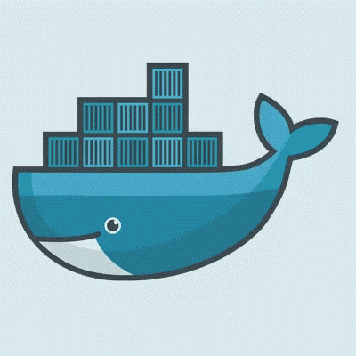
NAGP
Complex is Simple
Docker

Slide 48
Agenda
1
What are Containers
5
Explore dockerfile
2
6
Hands on
Docker
3
Layers
7
Docker architecture
4
Basic commands for docker
8
Orchestration

Slide 49
What are containers

Slide 50

Applications
Dev Server
Test/Production Server
Application
Application
Libraries (Version 1.0)
Libraries (Version 2.0)
Operating System
Operating System

Slide 51

Virtual Machines
Dev Server
Virtualized Server
VM Image
VM Image
VM Image
Application
Java Web App
Application
Libraries (Version 1.0)
Java 8
Libraries (Version 1.0)
Guest Operating System
Guest Operating System
Operating System
Hypervisor
Host Operating System
Notes:
Should I remove the left image?

Slide 52
Containers
Virtualized Server
Server
VM Image
VM Image
Container
Container
Application
Web App
Application
Web App
Libraries ( version 1.0)
Version 2
Libraries (Version 1.0)
Version 2
Guest Operating System
Guest Operating System
Hypervisor
Docker Engine
Host Operating System
Operating System

Slide 53
Containers
Server
Virtualization of application instead of hardware
Runs on top of core OS
Doesn’t require dedicated CPU, Memory, Network. Its managed by core OS
Self contained environment
Container
Container
Application
Web App
Libraries ( version 1.0)
Version 2
Docker Engine
Operating System

Slide 54
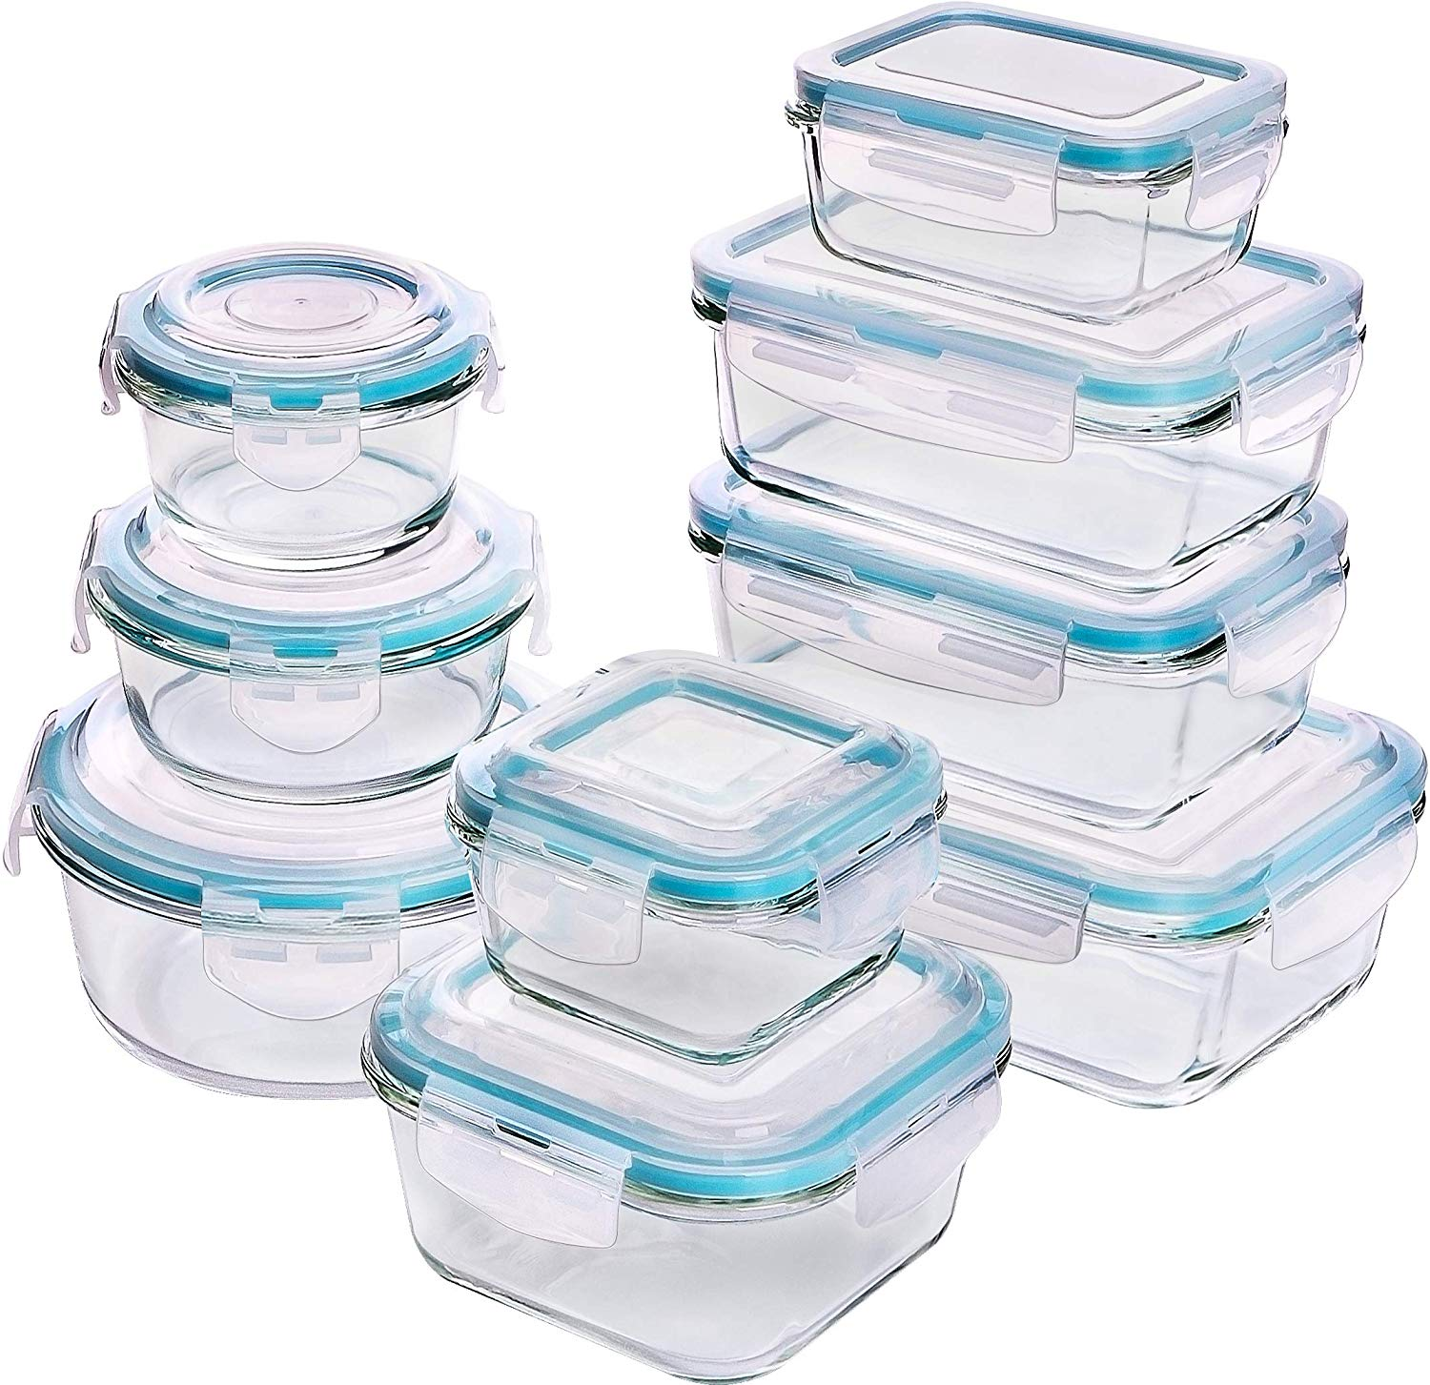
Why we need Containers?
And why we need them?
Help organize
Easy of transfer
Don’t mix the content
Save space and fit in anywhere

Slide 55
Quiz
Q1 : Containers running on a single machine all share the same operating system kernel, so they start instantly and make more efficient use of RAM
True
False
Correct Ans : TRUE
Q2: Virtual Machines,
Each virtual machine includes the application, the necessary binaries and libraries, and an entire guest operating system - All of which may be tens of GBs in size.
True
False
Correct Ans : TRUE
Q3: Containers include the application and all of its dependencies, but does not share the kernel with other containers
True
False
Correct Ans: FALSE
Notes:
True
True
False

Slide 56
Quiz
Q4: Virtual Machines run on top of?
Kernel
OS
Hypervisor
Correct Ans: Hypervisor
Q5: Containers run on top of?
Docker Engine
Hypervisor
Kernel
Correct Ans: Docker Engine

Slide 57
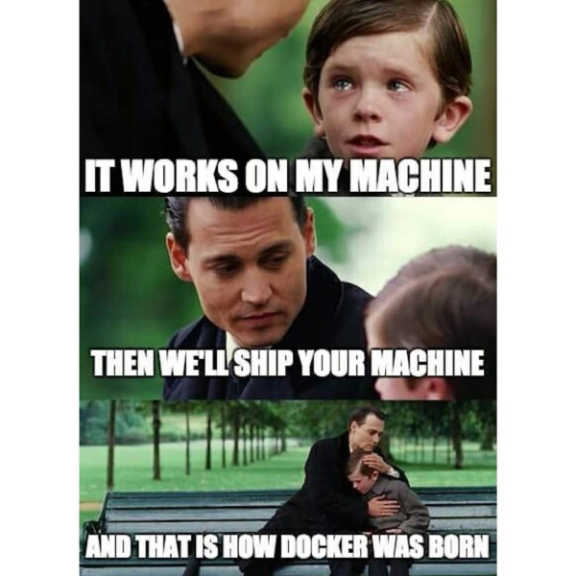
What is DOCKER
Runtime for containers
Open Source Container Runtime
Cross Platform
Rich community

Slide 58
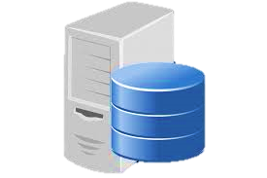
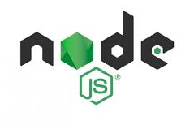
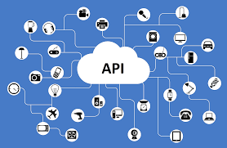
What all can docker do?
Run a database server?
Run web application in nodejs?
Provide API stub server
It’s not about your app. It’s not about what is inside your app to a large extent.
Its about packaging, shipping and delivering your app in a standard way.

Slide 59
HOW SIMPLE IT IS?
Docker makes this dead simple. Just a command and it will run
docker run -d -p 1234:8080 aarzootrehan/docker-web-app

Slide 60
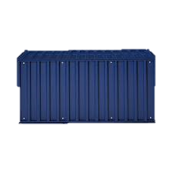
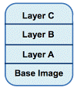
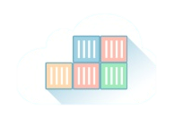
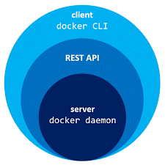
Some common terminology
1
Image
A Docker image is a file, comprised of multiple layers, used to execute code in a Docker container
2
Container
Running instance of an image
3
Registry
A common place where all the images are kept. Similar to maven, npm
4
Daemon
A server which runs in the background when docker runs

Slide 61

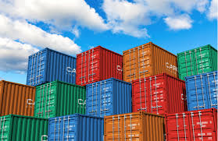
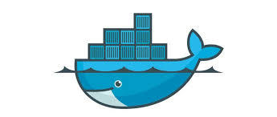
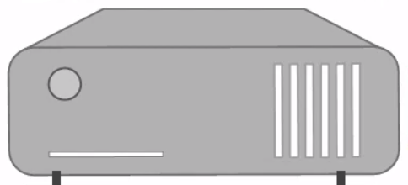
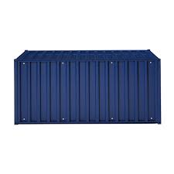

FLOW
Do I have hello world image?
$docker run hello world
Pull: “hello-world”
API CALL
Client
Daemon
Docker Host local image store
Hello world

Slide 62

Use cases of docker

Slide 63

Avoiding “It works on my machine” syndrome

Slide 64
Code Pipeline Management
Docker provides a consistent environment for the application from dev through production, easing the code development and deployment pipeline.

Slide 65

App Isolation

Slide 66

Rapid Deployment

Slide 67

Made for Microservices

Slide 68
Quiz
Q1: Running instance of an image is called?
Hypervisor
Container
Registry
Daemon
Correct Ans: Container
Q2: New images are pulled from ?
Containers
Registry
Hypervisor
OS
Correct Ans: Registry
Notes:
True
True
False

Slide 69
Quiz
Q3 : Docker is ?
A Layer on top of OS
Similar to virtual machine
Another name for containers
Runtime environment for containers
Correct Ans: Runtime environment for containers
Q4: _______________ is composed of “layers”
Containers
Docker Engine
Images
Registry
Correct Ans: Images
Notes:
True
True
False

Slide 70
Basic commands of docker
Docker version
Get the version of
Docker
$ docker version
Image list
List of running containers
$docker ps
To retrieve list of images
$ docker images
Docker
To retrieve the information of docker
$docker info
Running containers
Information about docker

Slide 71
Docker file (sort of making a PIZZA)
Dockerfile
Choose a Base (pizza base)
FROM node:8-alpine
Add your files (toppings)
COPY . .
Run any scripts (cook it)
RUN npm install
Start the app (serve the dish!)
ENTRYPOINT [ "node", "index.js" ]

Slide 72

Layers

Slide 73
What are layers
File generated from running a command
Ex: CMD: [“npm”, “start”] -> fdde3ea7cd0cad4
Id generated for each layer
Ex: fdde3ea7cd0cad4 id of layer
Notes:
Ask -> wriatble? For wht?

Slide 74

Layers

Slide 75
Hands on

Slide 76
Preparation
Create a acct.on hub.docker.com
Pull https://github.com/ryanp102694/tank-game.git
Run the app by modifying the package.json command start
Lets explore Dockerfile

Slide 77
Docker build
To build the docker image
docker build –t imagename:tagname pathofimage
docker build –t tankgame:tag1 .
To see the images
Docker images

Slide 78
Docker run
( Image name should be username/imagename:tagname)
To run the docker image
docker run -p 49160:8080 –d imageName
To stop a container
docker ps
Docker stop containerId

Slide 79
Docker push
To push docker image to docker hub
docker push <username>/docker-web-app:latest
Docker push aarzootrehan/ta:tag2

Slide 80
Docker pull
To pull docker image
docker pull <username>/imagename:tagname

Slide 81

Docker workflow
Notes:
List down all the dependencies in a docker file.
Docker file produces a docker image.
Docker image runs the docker container.
Container is the runtime instance of docker image.
Uploads on docker hub.
Make dockerfile
Upload to docker hub
Versioning / tagging
Push to docker hub , registry
Pull an exisiting image run

Slide 82
Quiz
Q1. ________is a text document that contains all the commands a user could call on the command line to assemble an image.
Docker Compose
Docker Hub
Docker file
Correct Ans: Docker file
Q2. ________is a cloud-hosted service from Docker that provides registry capabilities for public and private content.
Docker File
Docker Hub
Hypervisor
Correct Ans: Docker Hub

Slide 83
Quiz
Q3. docker build –t myuser/repo_name:version is the command for what?
Running a docker container
Building an image
Listing the images
Correct Ans: Building image
Q4. Which command is used for fetching the list of running containers
Docker ps
Docker images
Docker ls
Correct Ans: docker ps

Slide 84
Container Orchestration

Slide 85

Real life analogy
You build an awesome application container image (let’s say from a Dockerfile)
You create containers from your image to run

Slide 86


Application lifecycle
The container is deployed in production
After increase in load, the service is scaled to multiple services, you can still manage a few of them.

Slide 87


But what if your application becomes viral and you need to manage the traffic from whole world?
It becomes impossible to manage all the containers manually
Difficult to keep track of running containers, restarts and resource management
Releasing new versions require special rollout strategies, shutting down and restarting containers in a managed way
Logging, monitoring and load balancing need to be scalable as well.

Slide 88
Solution?

Slide 89

Orchestration

Slide 90



Orchestration tools
Docker Swarm

Slide 91

Docker Compose
Developed by Docker Inc
Used for running multi container applications
Used for running containers on a “single” node
Manages network and volume configuration for the containers
A docker-compose.yml file has all the configuration.

Slide 92

Docker swarm
Developed by Docker Inc
Used for running containers in a cluster of nodes.
One master manages the services deployment on worker nodes.
Allows scaling of services on all nodes
Service Discovery
Load Balancing

Slide 93
Kubernetes
Developed and Open sourced by Google
Built in service discovery, load balancing
Provides strong set of APIs, command line tools for operation
Provided as a managed service by many Cloud Providers (GCP, AWS and Azure)
Build in tools for logging and monitoring
Provides declarative API for scheduling workloads

Slide 94
Thank you !!

